Slide 1
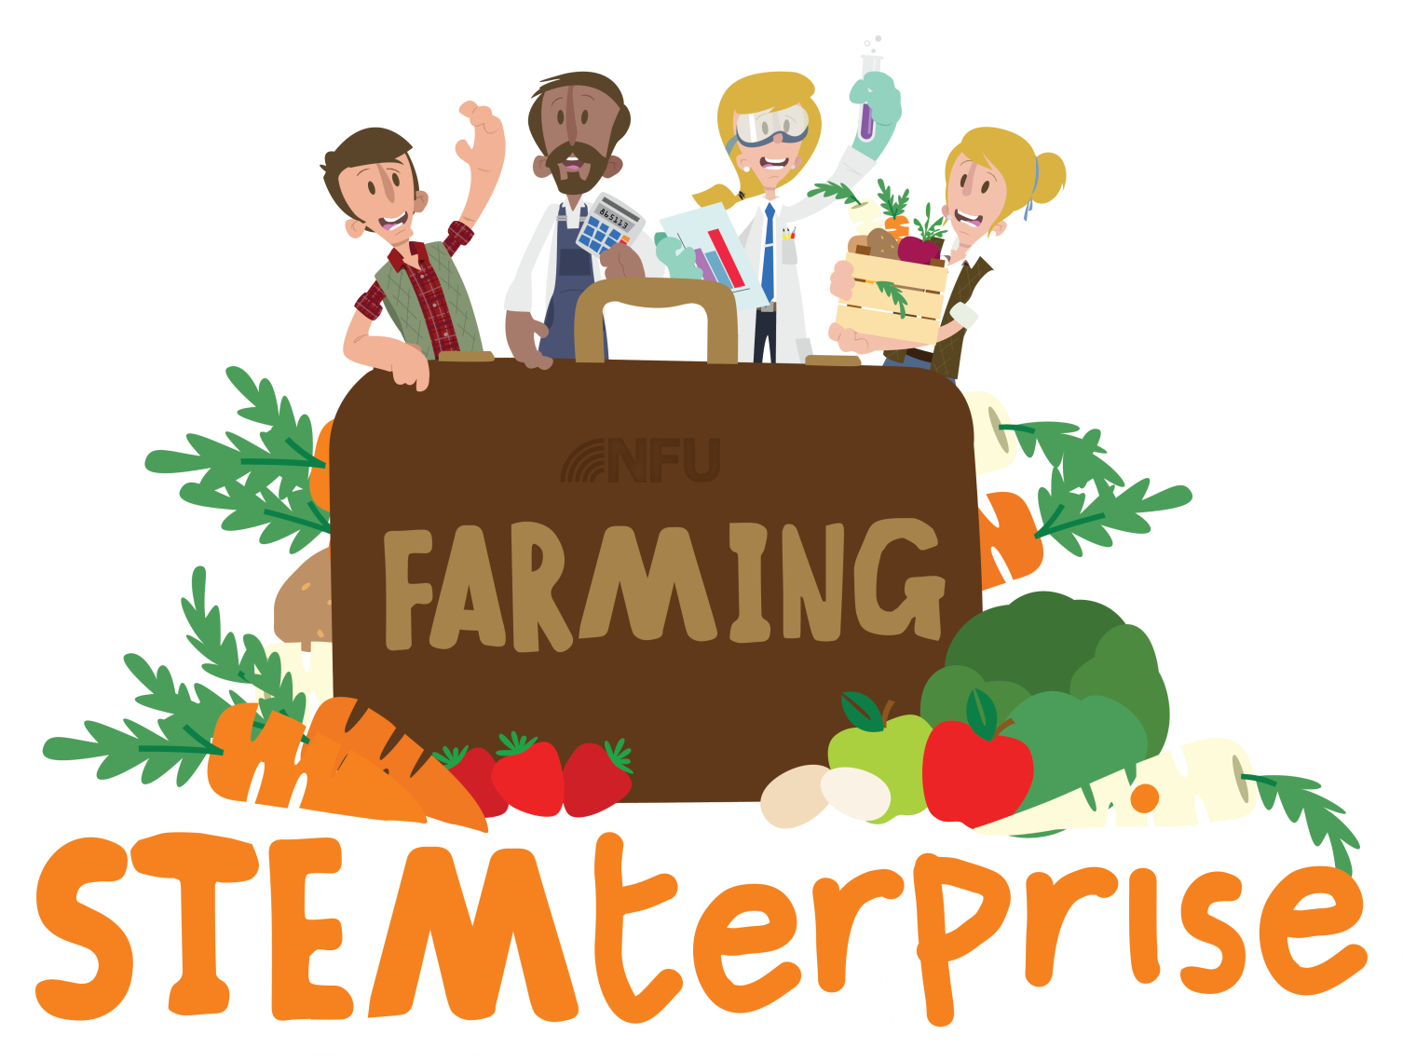
Stage 7: Making a dairy product

Slide 2
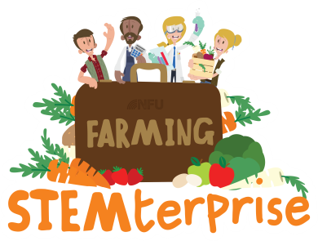
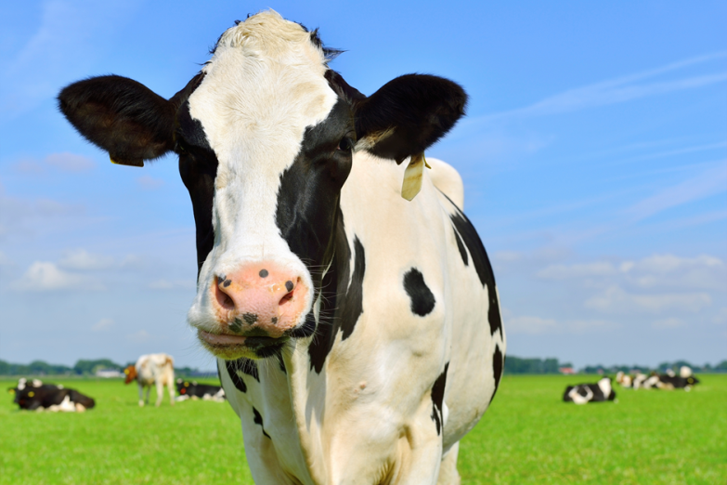
Learning Objectives:
• To understand how dairy products are made
• To make a dairy product
Talk to your partner:
What is a dairy product? Where do they come from?
How many dairy products can you remember?

Slide 3
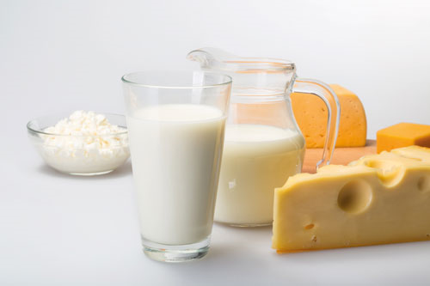
Nutritional benefits of milk
Milk is high in protein and helps our body grow.
It is high in calcium and vitamin D which help keep our bones and teeth healthy.
Did you know? To get the same amount of calcium that is in one glass of milk, we would have to eat 11 portions of spinach, 4 portions of broccoli and 63 Brussel sprouts!

Slide 4
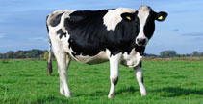
Processing milk
Dairy cows produce milk and have to be milked twice a day. The milk has to be quickly stored at a low temperature to keep it fresh. It is then taken to a dairy to be processed.
At the dairy, the milk is pasteurised which involves it being heated up very quickly and cooled down again to kill any harmful bacteria.
After that, the milk is separated into its cream and liquid components before being standardised (re-blended so that the milk contains the amount of fat required e.g. semi-skimmed).

Slide 5
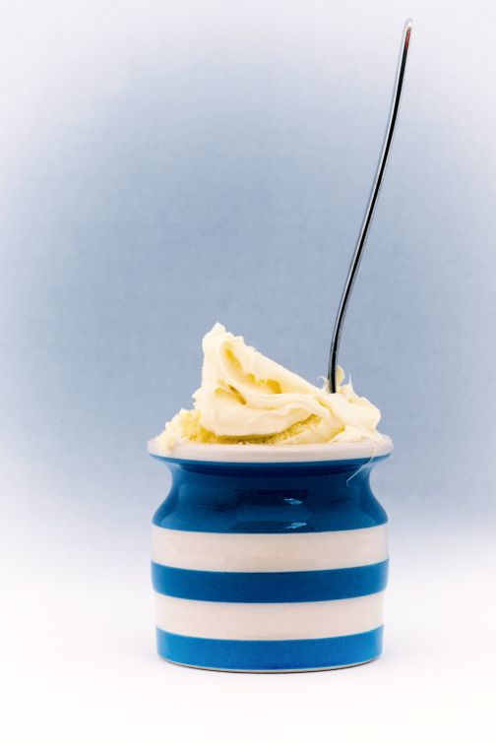
Cream
The fat and liquid content of fresh unpasteurised milk quickly separates and the fat rises to the top. This fat layer is known as cream.
Once the cream has been separated from the milk, it is pasteurised.

Slide 6
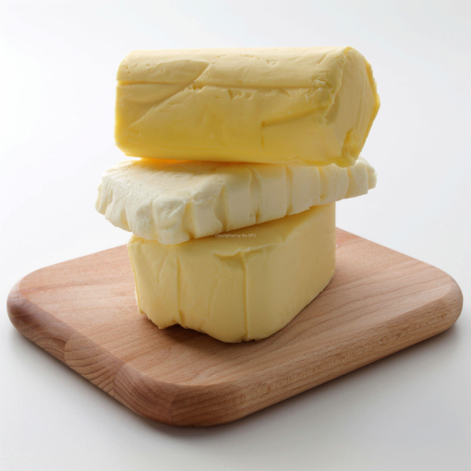
Butter
Once the cream has been separated from the milk, it can be turned into butter by continuously churning it to separate the solid milk fat from the liquid buttermilk.
Today, we will be completing this process for ourselves and making our own butter that we can use to make our food products.

Slide 7
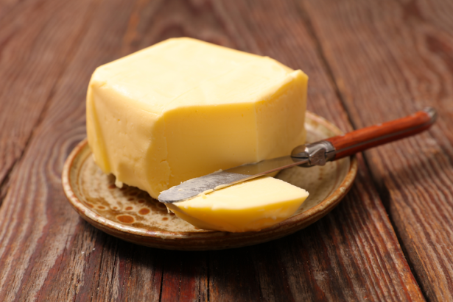
Making our own butter
We need to fill our containers so that they are approximately a third full. How can we use Maths to help us do this?
Once the cream has been added to the container, screw the lid on tightly.
Take turns to shake the container for up to half an hour while you compete in the Dairy Olympics!
Observe the changes that your cream goes through- what do you notice?
Pour away the buttermilk and refrigerate your butter, ready to use in your recipe in Stage 8!

Slide 8
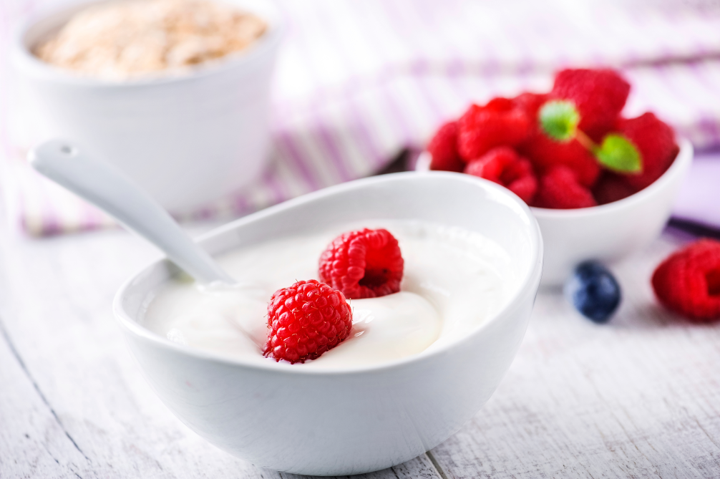
Yoghurt
To make yoghurt, harmless bacteria are added to pasteurised milk.
The bacteria produce lactic acid, which thickens the milk and turns it into yoghurt.

